Slide 1



Slide 2
FLORIDA’S TESTING INCREASE:
FROM DIAGNOSTIC TO SURVEILLANCE

Slide 3



APRIL 29, 2020
DeSantis said Wednesday that Floridians should not be alarmed when they see a rise in COVID-19 cases in the next few months. He said cases will rise as testing rises, and he predicted the state could see more than 2,000 positive cases per day in the future, a figure the state has not yet seen.
“We are trying to build a foundation for the future of the State of Florida,” DeSantis said. “I’m confident this will be a good roadmap.”

Slide 4
DAY-TO-DAY TESTING NUMBERS
FL STATEWIDE

Slide 5
COVID-19 TESTS PER WEEK
FL STATEWIDE

Slide 6
TOTAL TESTS VS. POSITIVE CASES
FL STATEWIDE

Slide 7
TOTAL TESTS VS. PERCENT POSITIVE
FL STATEWIDE

Slide 8
TESTING TARGETS:
Mass testing of individuals in high risk environments
  Migrant/farm workers
  Jails and prisons
  Long-term care facilities
Widespread testing of asymptomatic people

Slide 9
WATERMELON FARM EXAMPLE: ALACHUA COUNTY
100 Workers Tested
90 Positive Cases
90% Positivity

Slide 10
INDUSTRIAL FACTORY EXAMPLE: CENTRAL FLORIDA
214 Employees Tested
77 Positive Cases
36% Positivity

Slide 11
AIRPORT EXAMPLE: CENTRAL FLORIDA
Nearly 500 Workers Tested
260 Positive Cases
52% Positivity

Slide 12
INDIANTOWN: MARTIN COUNTY
118 Migrant/Farm Workers Tested by DOH/DEM Mobile Lab
54 Positive Cases
46% Positive

Slide 13
INDIANTOWN AREA: MARTIN COUNTY
1,792 Tested
528 Positive Cases
29.5% Positive

Slide 14
JAILS: LAKE COUNTY EXAMPLE
160 Staff/Inmates Tested
100 Positive Cases
63% Positivity

Slide 15
IMMOKALEE AREA: COLLIER COUNTY
5,182 Tested
1,178 Positive Cases
23% Positivity

Slide 16
CONSTRUCTION WORKERS IN NORTHWEST FLORIDA
15 Households Tested
In 2 Zip Codes
53 Positive Cases

Slide 17
FLORIDA LONG-TERM CARE FACILITIES UPDATE

Slide 18
The State has tested or ensured availability of testing for ALL residents and staff at Florida nursing homes and assisted living facilities.

Slide 19
APRIL 11 TO JUNE 12:
Mobile Testing Teams
Mobile Testing Bus
Deployed Test Kits
Vendor Supported Testing

Slide 20
AHCA issued emergency rules requiring mandatory testing every two weeks of ALL staff in Florida nursing homes and assisted living facilities.

Slide 21
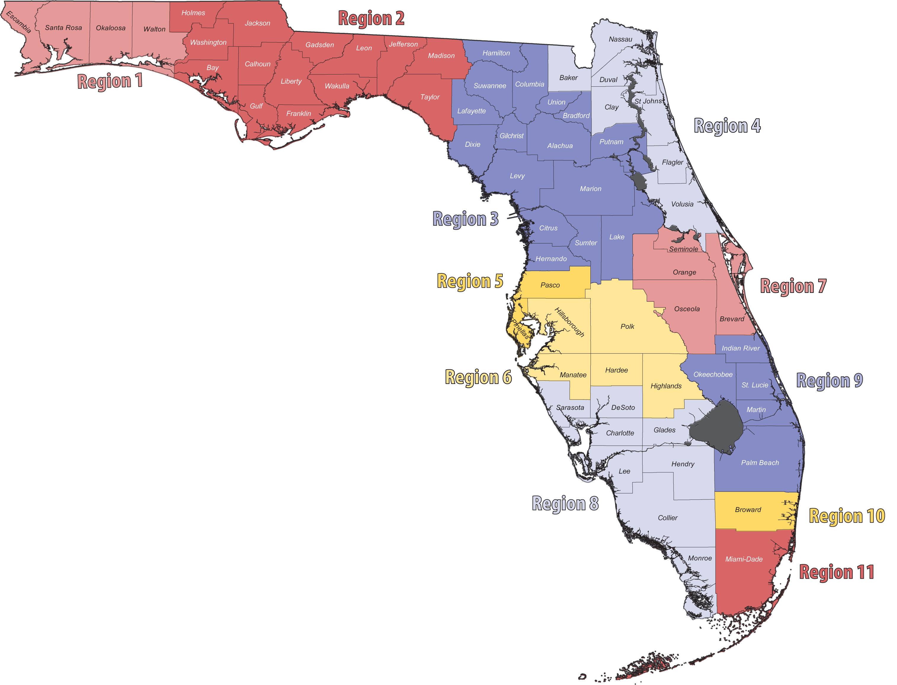
COVID-DEDICATED NURSING FACILITIES IN FLORIDA
Duval: Dolphin Pointe
146 Beds
Escambia: De Luna Health & Rehab Center
47 Beds
Leon: Port PruittHealth SouthWood
64 Beds
Polk: Oakbridge Building
120 Beds
Broward: NSPIRE Healthcare Lauderhill
60 Beds
Charlotte: Port Charlotte Rehabilitation Center
39 Beds
Miami-Dade: Miami Medical Center (Former Pan Am Hospital)
150 Beds
The facilities listed have executed agreements for COVID-dedicated buildings and/or wings.

Slide 22
FLORIDA LONG-TERM CARE FACILITY POSITIVE CASES

Slide 23
CLINICAL IMPACTS DUE TO COVID-19 IN FLORIDA

Slide 24
STATEWIDE COVID-19 POSITIVE ICU HOSPITALIZATIONS
April 15 vs. June 15
43%
Hospitalization data as reported by facilities to AHCA Emergency Status System (ESS).

Slide 25
STATEWIDE COVID-19 POSITIVE ON VENTILATORS
April 15 vs. June 15
56%
Ventilator data as reported by facilities to AHCA Emergency Status System (ESS).

Slide 27
FLORIDA COVID-19 FATALITIES
ASSOCIATED WITH LONG-TERM CARE FACILITIES

Slide 28
FLORIDA COVID-19 FATALITIES
NON-LONG-TERM CARE FACILITIES

Slide 29
WHO IS CONTRACTING COVID-19?

Slide 30
MEDIAN AGE OF COVID-19 POSITIVE INDIVIDUALS IN FLORIDA

Slide 31
Understanding Which Groups Are Most at Risk for COVID-19 Fatalities

Slide 32
FL COVID-19 Related Fatalities Ages 0-18: ZERO

Slide 33
86% of All FL COVID-19 Related Fatalities Have Occurred in Age Group 65+

Slide 34
More FL COVID-19 Related Fatalities Over Age 90 Than Under Age 65

Slide 35
THANK YOU

